Slide 1
DIGITAL STORE SALES ANALYTICS

Slide 2
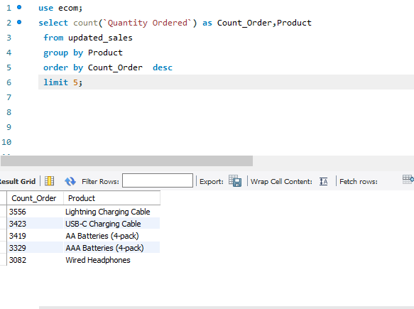
Top 5 Products Sold
Here are top 5 most sold Items
1.Lighting Charging Cable
2.USB-C Charging Cable
3.AA Batteries(4-Pack)
4.AAA Batteries(4-Pack)
5.Wired Headphones

Slide 3
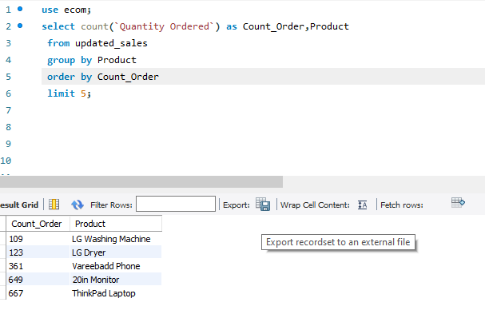
Top 5 Least Sold Items
Here are top 5 Least Sold Items
1.LG Washing Machine
2.LG Dryer
3.Vareebad Phone
4.20in Monitor
5.Thinkpad Laptop

Slide 4
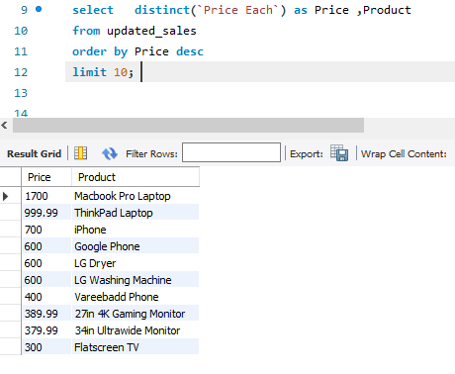
Most Priced Product
Here are the most 10 priced products
1.Macbook Pro Laptop
2.Thinkpad Laptop
3.iPhone
4.Google Phone
5.LG Dryer
6.LG Washing Machine
7.Verreebadd Phone
8.27n 4K Gaming Monitor
9.34n Ultrawide Monitor
10.Flatscreen TV

Slide 5
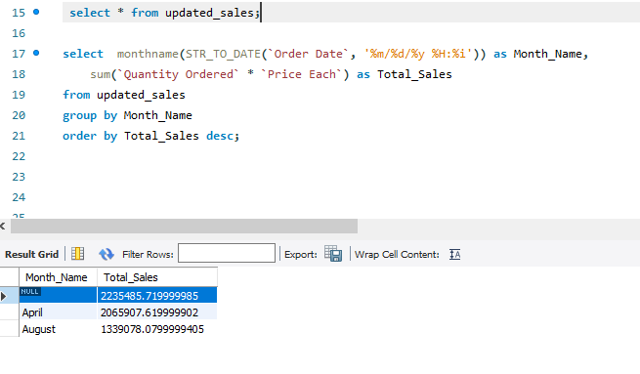
Monthly Sales Report
Net Sales In
April : 2235485
August:1339078

Slide 6
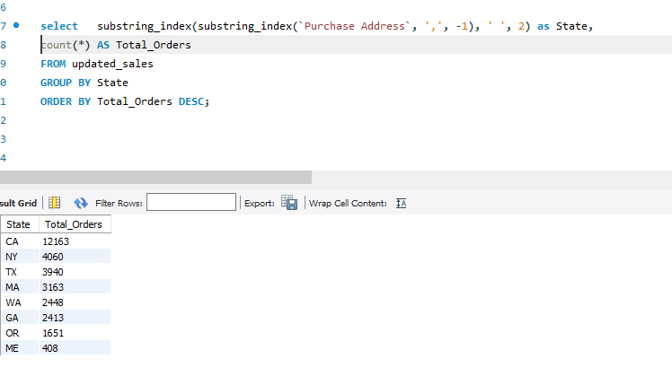
Statewise Sales

Slide 7
Insights
Top 5 Least Sold items are top 10 Most Expensive items. There might be a possibility of low sales due to their price.
April Month has highest sales in the Year.
Carlifornia State has the highest number of Purchase.

